Slide 1
Computer Concepts

Slide 2
A computer is an electronic device that:
accepts information and instructions from a user
manipulate the information according to instructions
display the information in some way
store the information for later retrieval

Slide 3
The categories of computers are:
Personal computers (PCs)
Desktops
Laptops
Subnotebooks (Ultraportables or Minis)
Tablets
Handhelds
Smartphones
MP3 players
Mainframes and supercomputers

Slide 4
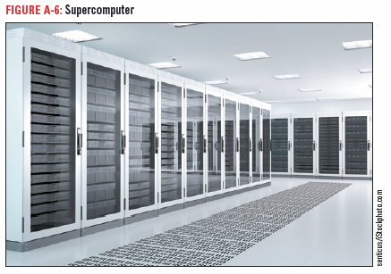
Mainframe computers and supercomputers are used by large businesses, government agencies, and in science and education. They provide centralized storage and processing, and can manipulate tremendous amounts of data

Slide 5
A computer system is made up of:
Hardware—the physical components
Software—the programs or data routines—instructions for the computer
Architecture or configuration is the design and construction of the computer.
Specifications are the technical details about each hardware component. An example would be the amount of memory, storage, and processing speed.

Slide 6
Data
Numbers, words, sounds, and graphics
Processing
Modifying data

Slide 7
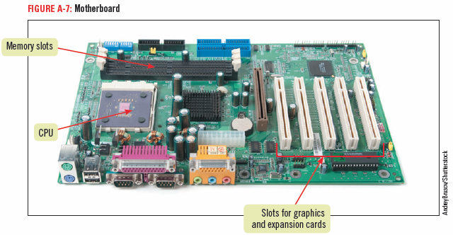
Computer System Components
Motherboard
located inside the computer
the main electronic component of the computer contains the CPU
Cards are removable circuit boards that are inserted into slots in the motherboard, for example, high end video cards or special audio cards.
Originally, people needed cards for usbs, video, audio, and networking; however, those features are built in now.
Cards act like converters allowing the computer to communicate with external devices.

Slide 8
Input — data you put into a computer (possibly names and addresses)
Output — result of the computer processing your input (could be those names and addresses alphabetized by last name) could be output to a computer monitor or a printer
Peripheral devices —they can do the input, output, and storage functions
Examples of peripheral devices that are used for input are keyboards, microphones, and scanners
Examples of peripheral devices that are used for output are printers and monitors

Slide 9
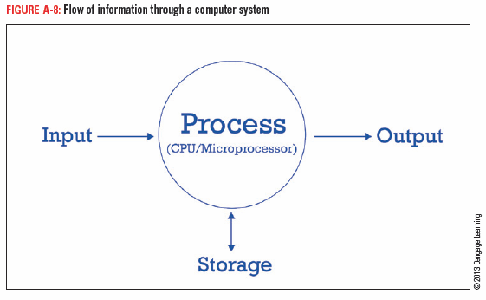
Microprocessor
also called processor, central processing unit or CPU
a silicon chip designed to manipulate data

Slide 10
Three types of storage media:
Magnetic storage media (disks)
Optical storage devices (DVD)
Flash memory (usb)

Slide 11
Common magnetic storage devices
hard disks—several spinning platters usually sealed in a case inside the computer
Optical storage devices
CD—stores 700 MB of data
DVD—stores 4.7-15.9 GB
Blu-ray—stores 25 GB, used for storing high-definition video (used to store movies)
MB megabyte
GB gigabyte or 1,000,000 megabytes

Slide 12
Flash memory (solid state storage) —can be written to more than once.
Flash memory cards
small, portable cards encased in hard plastic to which data can be written and rewritten
used in digital cameras, handheld computers, video game consoles, and other devices

Slide 13
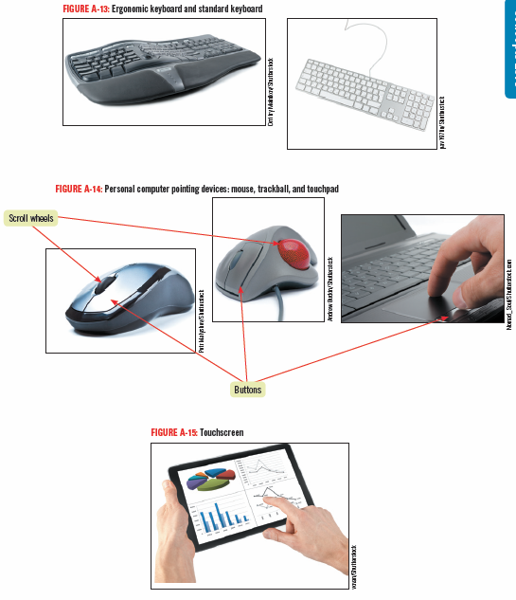
Some input devices are:
Keyboard
Pointing device
Mouse
Trackball
Touch pad
Touch screen
Microphone
Scanner

Slide 14
Computers Help the Challenged
People who cannot use their arms or hands instead can use foot, head, or eye movements to control the pointer.
An example is Stephen Hawking.
People with poor vision can use keyboards with large keys for input, screen enlargers to enlarge the size of objects on the monitor, or screen readers that speak on-screen content aloud.

Slide 15
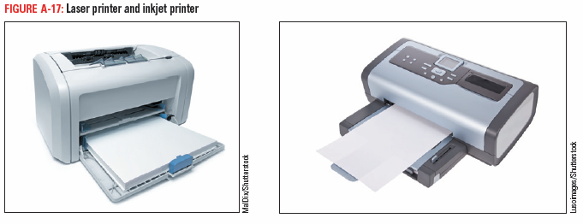
Types of printers
Laser– high quality
Inkjet– popular for home use
Dot matrix– used to print large quantities (not high quality )

Slide 16
Data communications is the transmission of data from one computer to another or to a peripheral device.
The four essential components of data communications are:
Sender the computer that originates the message
Channel message is sent over a channel, such as a telephone
Receiver the computer at the message’s destination
Protocols the rules that establish the transfer of data between sender and receiver. You can think of a protocol as a translator between devices so that they can understand each other.

Slide 17
Device driver (or driver)
Software that handles the transmission protocol between a computer and its peripheral devices
A computer program that can establish communication because it contains information about the characteristics of your computer and of the peripheral device
An example is a printer driver
Data bus (imagine a bus route)
Data path between the microprocessor, RAM, and the peripherals along which communication travels

Slide 18
Networks
Network
Connects one computer to other computers and their peripheral devices
Network Software
Establishes the communications protocols that will be observed on the network
Controls the traffic flow of data traveling through the network

Slide 19
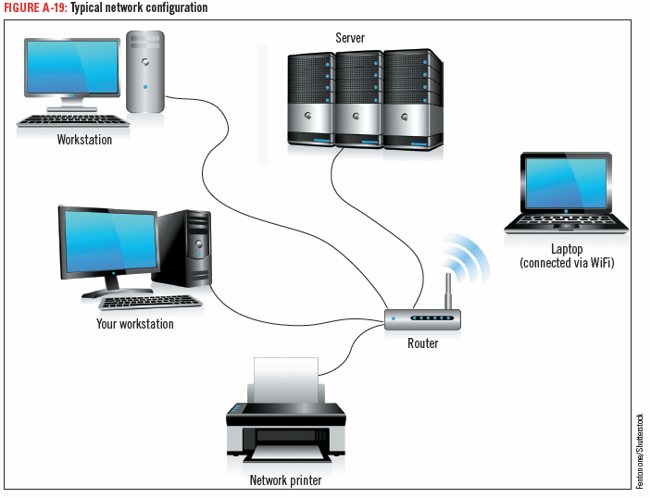

Slide 20
Server (computer)
acts as the central storage location for programs
provides mass storage for most of the data used on the network
our server at school stores our data files for classes (among other things)
Client/server network— a network with a server that acts as the central storage location
Peer-to-peer network
a network without a server
all of the computers are equal

Slide 21
Standalone computer—a personal computer that is not connected to a network
Workstation—a personal computer that is connected to a network
Node—any device connected to the network

Slide 22
LAN (local area network)
Nodes located close to each other
WAN (wide area network)
more than one LAN connected together
the Internet is the largest example of a WAN

Slide 23
Wireless Technology
Infrared technology—uses infrared light waves to beam data from one device to another
Bluetooth—uses short range radio waves to connect a device wirelessly to another device or to the Internet
These are nice because they cut down on the number of wires and cables in your office.

Slide 24
Security
This means the steps a computer user takes to prevent unauthorized use of or damage to the computer.

Slide 25
Malware (mal means bad)
any program intended to cause harm or convey information to others without the owner’s permission
Viruses
harmful programs that instruct your computer to perform destructive activities, such as erasing a disk drive
Antivirus software (virus protection software)
searches executable files for the sequences of characters that may cause harm and disinfects the files by erasing or disabling those commands
Spyware
secretly gathers information from your computer and sends this data back to the company or person that created it (it is watching you)
usually installed without the computer user’s permission or knowledge
Anti-spyware software detects spyware and deletes it

Slide 26
Firewall
Prevents other computers on the Internet from accessing a computer and prevents programs on a computer from accessing the Internet without the computer user’s permission
Can be either hardware or software
Hardware firewalls provide strong protection from incoming threats
Many routers come with built-in firewalls
Software firewalls track all incoming and outgoing traffic

Slide 27
Logging in / Logging on
signing in with a username and password
Strong password
at least eight characters
consists of uppercase and lowercase letters as well as numbers
does not include common personal information

Slide 28
System software helps the computer carry out its basic operating tasks.
The four types of system software are:
Operating systems (for instance, Windows, Unix)
Utilities (optimization)
Device drivers (for example, printer drivers)
Programming languages (sets of instructions) such as VBA and C++

Slide 29
Operating system (Windows is an example)
allocates system resources
controls the input and output (I/O)
manages files on storage devices
Operating environment
provides a graphical user interface (GUI) that acts as a liaison between the user and the computer

Slide 30
Utility software
helps analyze, optimize, configure, and maintain a computer
Device drivers
Handles the transmission protocol between a computer and its peripherals
When you add a device to an existing computer, part of its installation includes adding its device driver to the computer’s configuration
Programming languages
Used by a programmer to write computer instructions

Slide 31
Application software
Enables you to perform specific computer tasks such as word processing, organizing information in a database, etc.
You will be learning three application programs in this class
Document production software
includes word processing software, such as Microsoft Word
desktop publishing software such as Microsoft Publisher
has a variety of features that assist you in writing and formatting documents, including changing the font (the style of type), spell checking to help you avoid typographical and spelling errors, and adding simple drawings called clip art

Slide 32
Spreadsheet software
a numerical analysis tool, such as Microsoft Excel
used to create a worksheet composed of a grid of columns and rows you type data into the cells, and enter mathematical formulas into other cells that reference the data
used for budgets, and other financial purposes

Slide 33
Database management software
lets you collect and manage data (Microsoft Access is a database program)
Database
a collection of information stored on one or more computers organized in a uniform format of fields and records
field—one type of information in the record
record—a collection of related data items in a database
An example of a database is a client list as shown below.
fields
Title | First | Last | Street | City | State | Zip code
Mr. | John | Smith | 34 Elm | Brea | CA | 92877
Mrs. | Ivy | Morser | 435 Main | Reno | NV | 87309
records

Slide 34
Presentation software
Allows you to create a slide show to accompany a lecture or demonstration. PowerPoint does this. This is a PowerPoint slide show.
Information management software
Keeps track of schedules, appointments, contacts and to-do lists
An example is Outlook, even though it is primarily used for e-mail
Website creation and management software
Allows you to create websites. An example would be Dreamweaver. We offer a class in this program at this school.

Slide 35
Finis

